Slide 1

Exploration Through Augmented and Virtual Reality
Team Members:
Rohini Yedelli
Vaibhav Goyal
Radhika Raghuwanshi
Mentor: Mrs. Smita Jangale

Slide 2

Introduction To Augmented and Virtual Reality :
Virtual Reality is a computer simulated reality which replicates a real environment, and simulate a user's physical presence in this environment while Augmented Reality blurs the line between what's real and what's computer-generated by enhancing what we see, hear and feel.

Slide 3
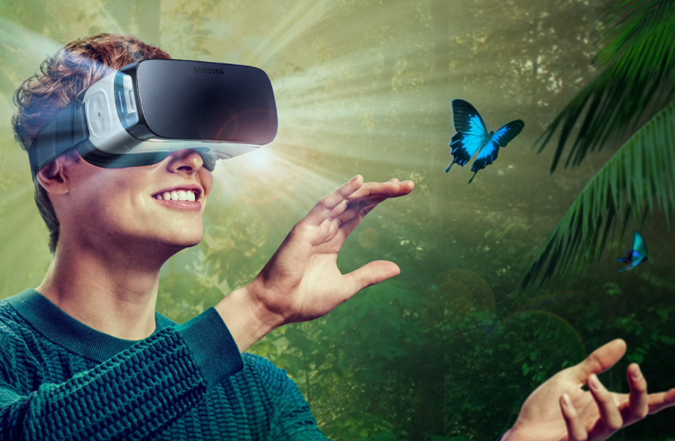
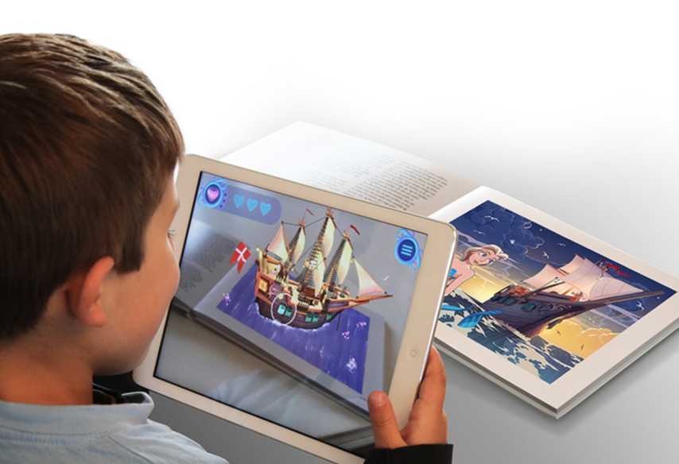

Slide 4

Project Idea
The project will be an android application
based on Recognition based Augmented Reality.
The android application will have a storytelling
platform. This platform will depict the story when the target/storybook is seen through the android application. The application will help to inculcate learning and will provide amazing experience to kids.

Slide 5

Suggestions provided in last review -
To demonstrate a static/dynamic object projected onto a target.
Demonstration of suggestion provided -
A 3D object is being projected onto a 100 Rs note/target .

Slide 6

Objective
“Exploration” will help to inculcate learning and provide amazing experience to kids as well as adults. It will provide them a whole new look towards virtual world using Virtual and Augmented Reality.

Slide 7
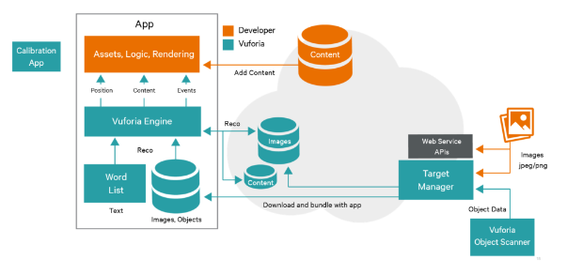
System Design

Slide 8
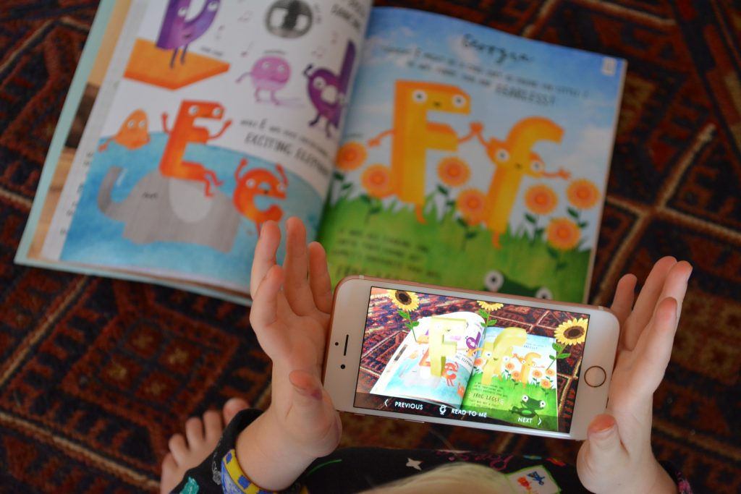
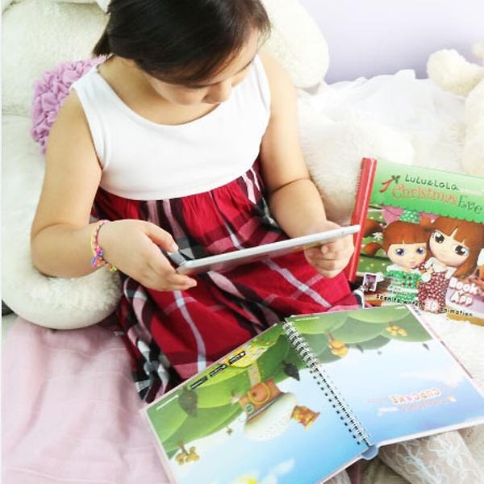
Expected Outcome

Slide 9

Hardware/Software Requirements
Unity3D (Personal edition)
Vuforia
C#
VR Headset
Smartphone with Gyroscope and Magnetometer
sensor

Slide 10
Test cases
Test Case 1:
Target Object : 100 Rs Note
3D model : Animated butterfly rendered on the target object
Test Case 2:
Target Object : 100 Rs Note
3D model : Static 3d car model rendered on the target object

Slide 11
END

